Slide 1
One Portal, Every Campus: A Unified Student Portal for Inter-College Hackathons & Events
TEAM - 4

Slide 2

Why This Platform Is Required?
Right now, Event discovery is scattered across Instagram stories, WhatsApp groups, and random Telegram channels, where there is no verification of whether the source is trusted or not. A central platform for all college events and hackathons is genuinely helpful.
Cross-college Collaboration is Lacking, Many colleges don’t collaborate or even know what’s happening outside their bubble. This will solve that.
Students from Low-Tier Colleges where there are less opportunities for students to participate in events, they get a platform to enroll in other colleges events.
Students can work with other colleges students on their projects and get to learn a lot. Helpful finding people good in specific expertise.
Students find difficult making teams in hackathons and events, Now they can post requirement for students enrolling in same event and choose on their skill set.

Slide 3

KEY FEATURES
Event Posting Allow students or college clubs to create and post events like- hackathons, coding contests, workshops, Sports Events, Debates, etc.
Get matched with people looking to join the same event as you based on skills, time zone, availability. Add resume & GitHub profile.
Can post requirements on project and get talents from other colleges excellent in their expertise. Student get opportunity to work on projects based on their skills.

Slide 4

Event Discovery Allow users to filter/search by: College, Tech, Domain, Date, Location, Online/Offline.
Students can register/log in using email or college credentials. College Verification (using email domains like @iitb.ac.in) to prevent spam. Can see their past events, interests, or even host events.
Notify users when a new event matches their interests or from a favorite college.
Users can express interest or register. Leaderboard/Rewards for active users.

Slide 5
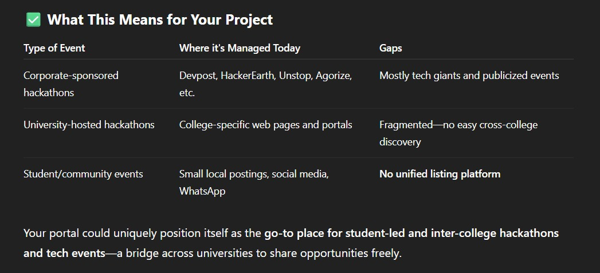
THIS PROJECT SOLVES PROBLEM OF THE STUDENTS AND THERE IS NO ONE DOING THIS.

Slide 6
Team: Rahul Singh (Lead) Rishabh Kumar Prasun Mittal Yogendra Palhawat
thank You

